Slide 1
Introduction to Flutter
Om Gaikwad
D15A 16
Compensation work for Quiz 1
Developed by Google
Open-source UI software development kit
Cross-platform framework for building mobile, web, and desktop applications

Slide 2
Key Features
Widgets: Rich library of pre-designed UI components
Material Design & Cupertino: Built-in design languages for Android and iOS respectively
Dart Programming Language: Modern, object-oriented language optimized for building user interfaces
Access to device features: APIs for accessing device functionalities like camera, geolocation, and sensors
Community support: Active developer community contributing plugins and packages

Slide 3
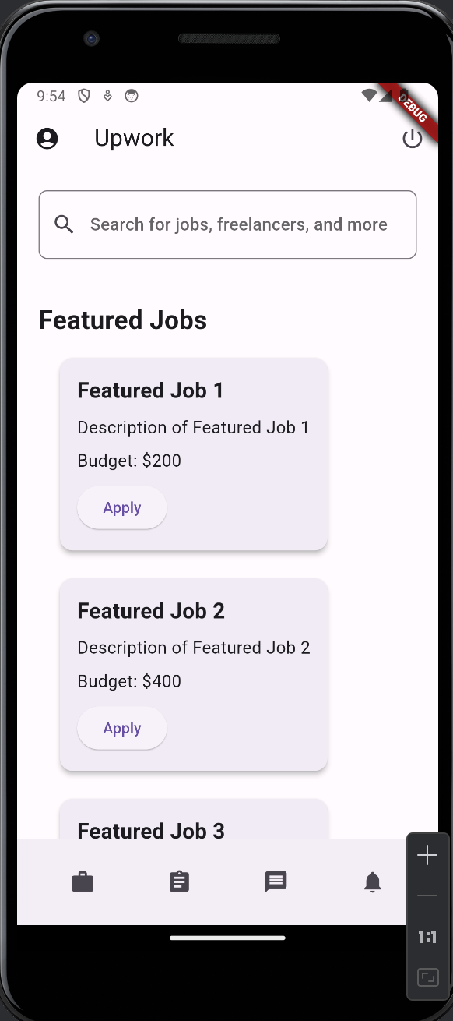
Home Page
The Upwork Clone Home Page is a key component of our project, designed to replicate the functionality and aesthetics of the original Upwork platform.
Key Features:
Search Functionality
Featured Jobs Section
Recommended Freelancers
User Authentication
Navigation Bar

Slide 4
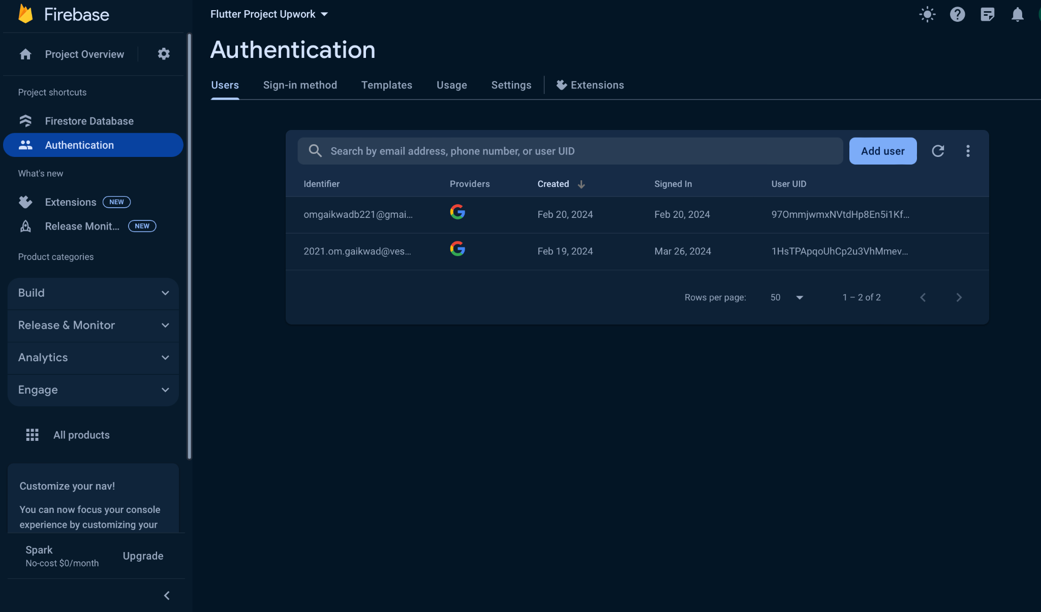
Firebase Authentication Storage

Slide 5
Firebase Authentication Storage
Integration: Utilizes Firebase Authentication for secure user authentication and storage.
Data Security: Firebase Authentication stores user credentials securely, safeguarding sensitive information.
Authentication Methods: Supports various authentication methods such as email/password, Google Sign-In, and more.
Scalability: Provides scalable authentication solutions suitable for apps of all sizes, from small startups to large enterprises.
Ease of Integration: Firebase Authentication seamlessly integrates with Flutter apps, offering a hassle-free authentication process for users.

Slide 6
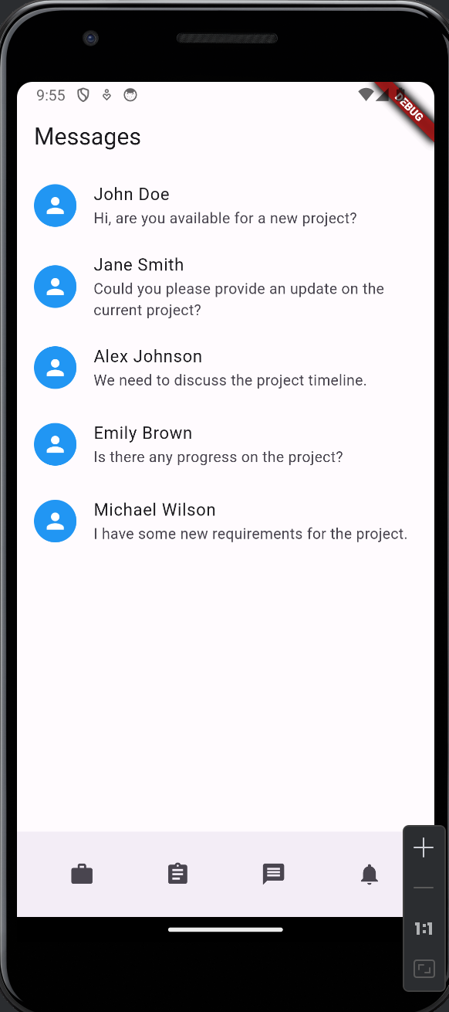
Messages Page
Introduction to Messages Page:
The Messages Page is a vital component of our Upwork clone, facilitating communication between freelancers and clients. It serves as a centralized platform for managing conversations related to projects and job opportunities.
Key Features:
Conversation List: Displays sender's name, profile icon, and latest message.
Conversation Screen: Dedicated screen for viewing conversation history and sending messages.
Real-time Messaging: Firebase Firestore enables seamless, real-time communication.
Navigation Integration: Easily accessible via bottom navigation bar for quick updates on project discussions.

Slide 7
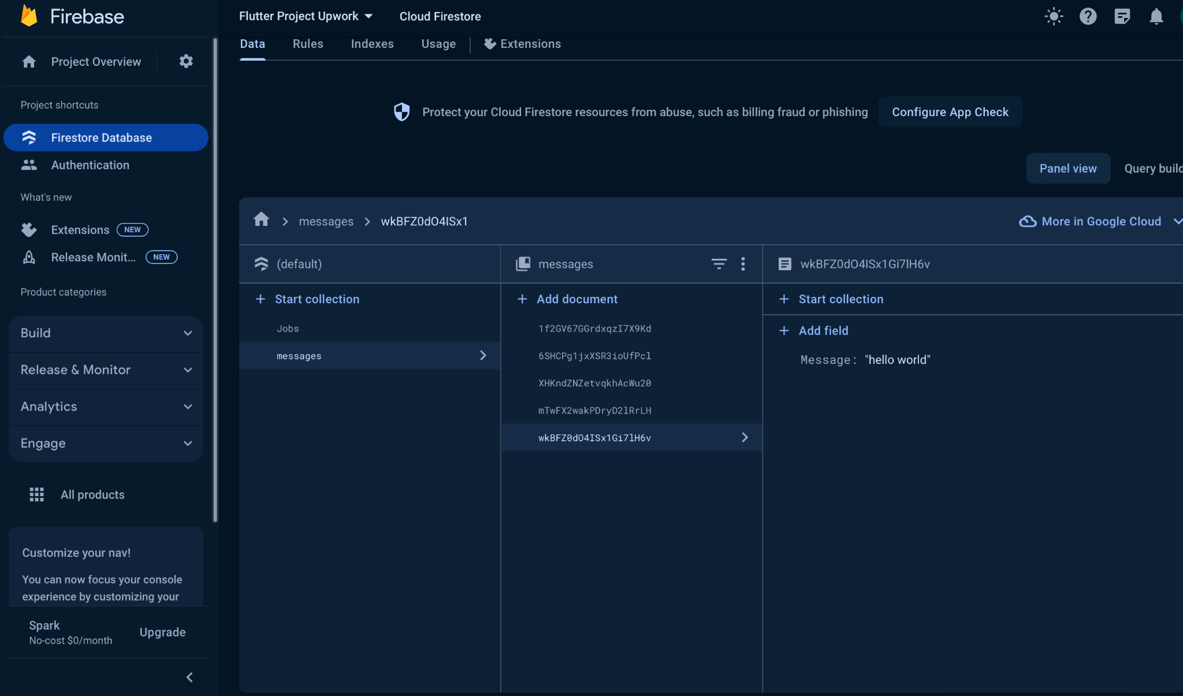
Firebase database
\

Slide 8
Firebase Database Connectivity
Integration: Utilizing Firebase Firestore for seamless data storage and retrieval.
Message Saving: Messages sent in conversations are securely stored in Firebase Firestore.
Real-time Updates: Enables real-time synchronization of messages across devices.
Efficient Data Management: Provides scalable and reliable data storage for managing conversation history.

Slide 9
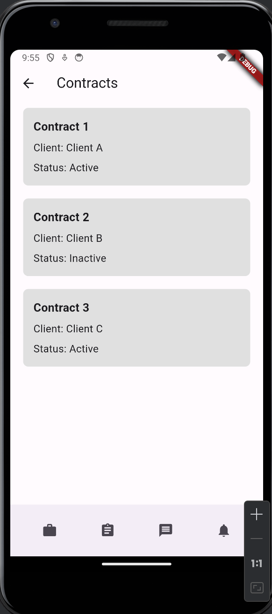
Contracts Page
Purpose: Displays contracts with clients, providing an overview of active and inactive engagements.
Features:
Utilizes ContractBlock widgets to present contract details such as title, client name, and status.
Supports navigation through bottom navigation bar icons for seamless transition between Jobs, Contracts, Messages, and Notifications.
Design:
Clean and minimalist design with grey background and simple text formatting for improved readability.
Each ContractBlock is visually distinct, enhancing user experience and navigation.

Slide 10
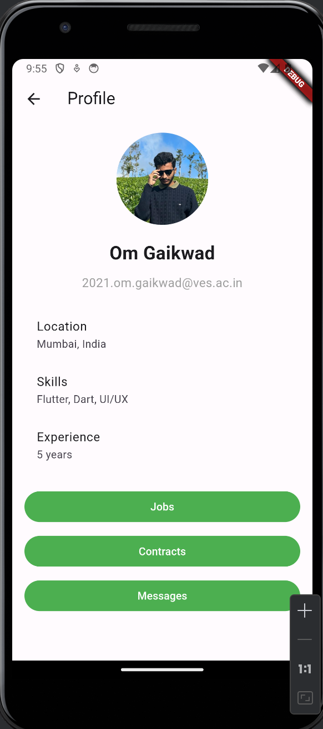
Profile Page
Purpose: Provides a platform for users to view and manage their profile information.
Features:
Displays user's profile picture, name, and email for identification.
Includes details such as location, skills, and experience to showcase user expertise.
Allows navigation to Jobs, Contracts, and Messages pages for further interaction.
Design:
Utilizes a clean layout with profile picture, name, and contact details at the top.
Organizes additional details such as location, skills, and experience in a structured format.
Offers easy navigation buttons styled with green color for seamless access to other pages.

